Slide 1
AI Summary for Video Content
Group number: 18
Group member:
Qiao HE Jiayi HUA
Zhimin MEI Zhengxin YOU
Notes:
Hi everyone. We are group 18. the name of our project is AI summary for video content

Slide 2
CONTENT
Introduction
System Architecture
Implementation
Novelty
Demonstration
Notes:
I would like to introduce our project from this five parts. Introduction, system architecture, implementation, demonstration and novelty.
First I will give an introduction to the application scenario and background of our project.

Slide 3









Introduction
Found an interesting video，
but don't have time to watch it.
Facing lengthy online course records，
want to quickly know the key points.
99.9% of people don’t know …
Saw an eye-catching video,
but don’t want to be deceived
by clickbait.
Can you believe it？ President Biden did this …
Notes:
Do you have such experiences? You see a video that you are interested in, due to time constraints, you don't want to start from scratch, but you really want to know what it is about. You have to watch a lengthy online course records to get the key points. Or you saw an eye-catching video, but you are worried that it is a clickbait
If you have such experiences. Our project may help you.
For individual Clickbait 标题党 long video meeting content save time
For company, they also need to deal with “clickbait”. Punish these videos. https://fanyi.baidu.com/?aldtype=16047#zh/en/%E6%A0%87%E9%A2%98%E5%85%9A
Based on document summarization
Existing methods for document summarization
https://www.i3zh.com/22765.html

Slide 4
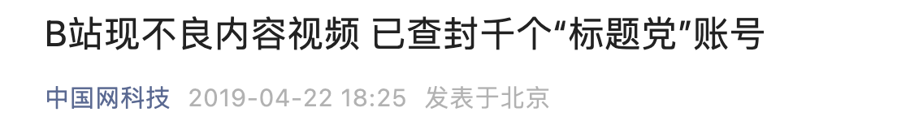
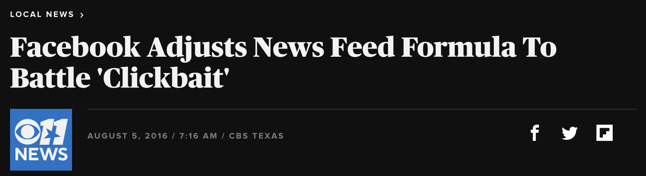
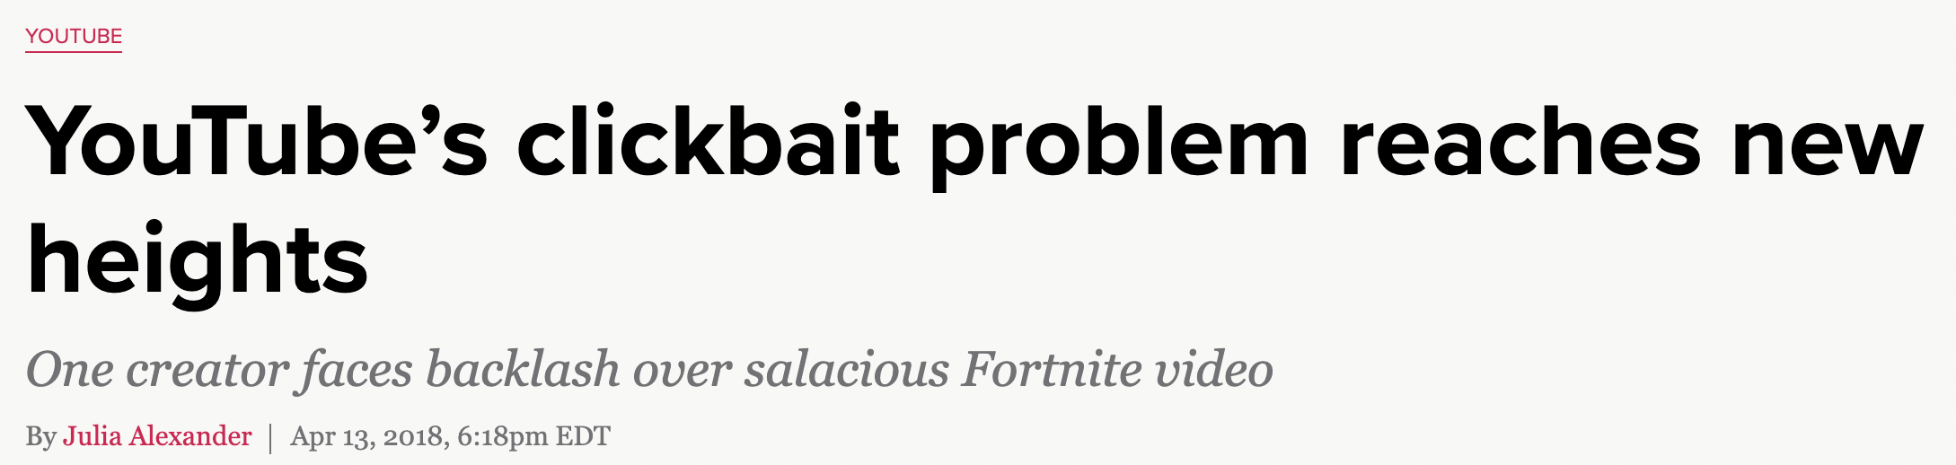
Introduction
AI summary for video content based on GPT.
Given a Bilibili video link, it fetches the text content about the video, sends it in a prompt to the GPT and generate summary.
Then streams the response back to the user.
Save time and energy for individuals
Companies need to deal with “clickbait” issue
Notes:
Our project is a tool that use AI to generate summary for video content.
Generally, given a bilibili video link, it can fetches title，bullet screen and so on about the video, sends it to a GPT and get summary. Then streams the summary to the user.
This project can help individuals save time and energy
Also, it is a potential way for companies to deal with clickbait issue.

Slide 5
Introduction
Document Summarization
Extractive summarization
Identifies relevant subset sentences from the input text and uses them verbatim while still maintaining the original context of the input text.
Abstractive summarization
Produces summary by generating entirely new text that conveys important information from the original text.
Notes:
Our project is a specific application scenario of document summarization task in NLP field.
Document summarization can be roughly divided into extractive summarization and abstractive summarization. Where extractive summarization means identifying subset sentences and using them verbatim as summary. Abstractive summarization generates entirely new text that conveys important information from the input text.
We chose to use the second way because the texts collected from video are often not complete sentences,
abstractive summarization can generate summary with high readability based on incomplete sentences. And recently, some large pre-trained Language models have achieved remarkable performance in this field.

Slide 6
System Architecture
Frontend
Frontend
user interaction and results display
Backend
parses the query from frontend generates the results to return to frontend, update the model
User interaction
Results display
query
results
Backend
Query parsing
Text content crawling
Text content analysis
Data storage
Prompt generation
Model update？
Prompt- tuning
Summary generation
Notes:
Second, I'd like to show the architecture of our project. Our project can be divided into two parts, the frontend and backend.
Frontend is in charge of user interaction and results display. Backend parses the query from frontend, generates the results to return to frontend, and can update the model.

Slide 7







System Architecture
Prompt/prompt-tuning
Workflow
Get video source
Post source and settings
Crawl the content
Generate prompt
Get summary
Send back to users
Generate prompt
Prompt-tuning？
Update the model？
…
text
content
summary
Server program
OpenAI API
crawler
Link
settings
summary
Fine-
tuning
Model
Video source
browser
Link
settings
Could server
summary
link
user
Notes:
This is the workflow of the system. For users, they provide the source of the video and click the “summarize” button, then the browser post the source and corresponding user settings, like the length of the summary, to server side. The server will crawl the content from the source, including title, subtitle, description, comments and bullet screen. Next, the server generate a prompt based on the content and send to GPT3.5? using OpenAI API to get the summary. The summary will be sent back to users.
In server side, before the deployment of the project, we also prompt-tuning the original GPT3 model to improve the performance of the model. Update of the model is available.

Slide 8
Implementation
Language: TypeScript, JavaScript
Environment:
Node.js 18 (for both backend and frontend) https://nodejs.org/en
Tools:
OpenAI GPT3.5 https://platform.openai.com/docs/api-reference/introduction
Vercel https://vercel.com/features/edge-functions
Redis https://redis.io/
Next.js https://nextjs.org
Notes:
To Implement this system, we use chatGPT3.5 api
We use vercel platform to deploy our project, redis for data cache.
每一部分用到的工具及链接
Vercel 将服务器程序部署在 Serverless Function 上

Slide 9
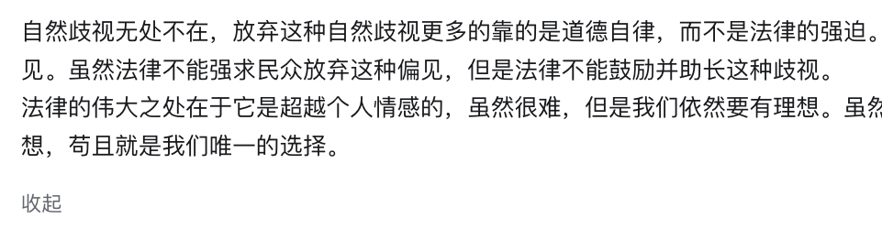
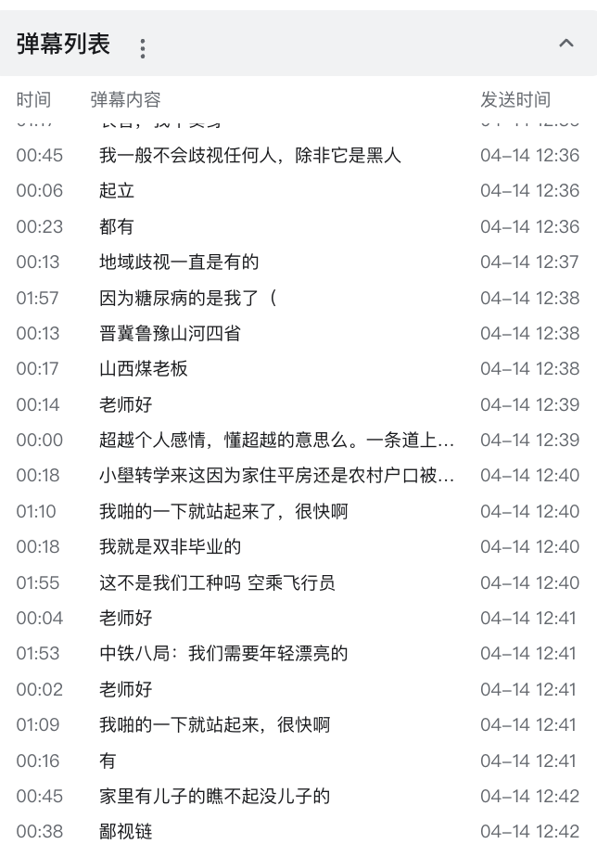
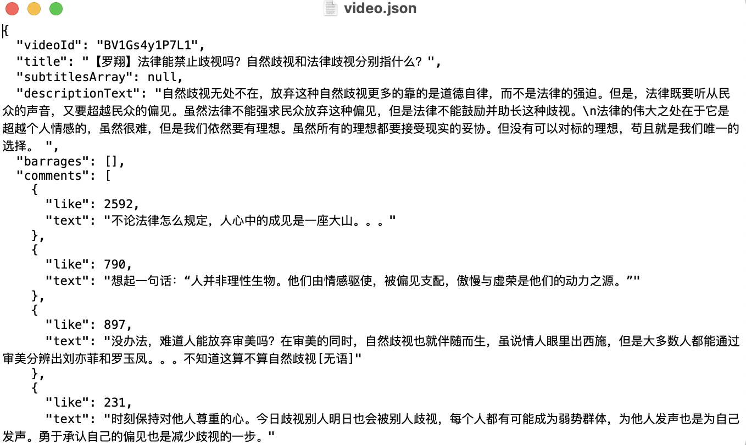
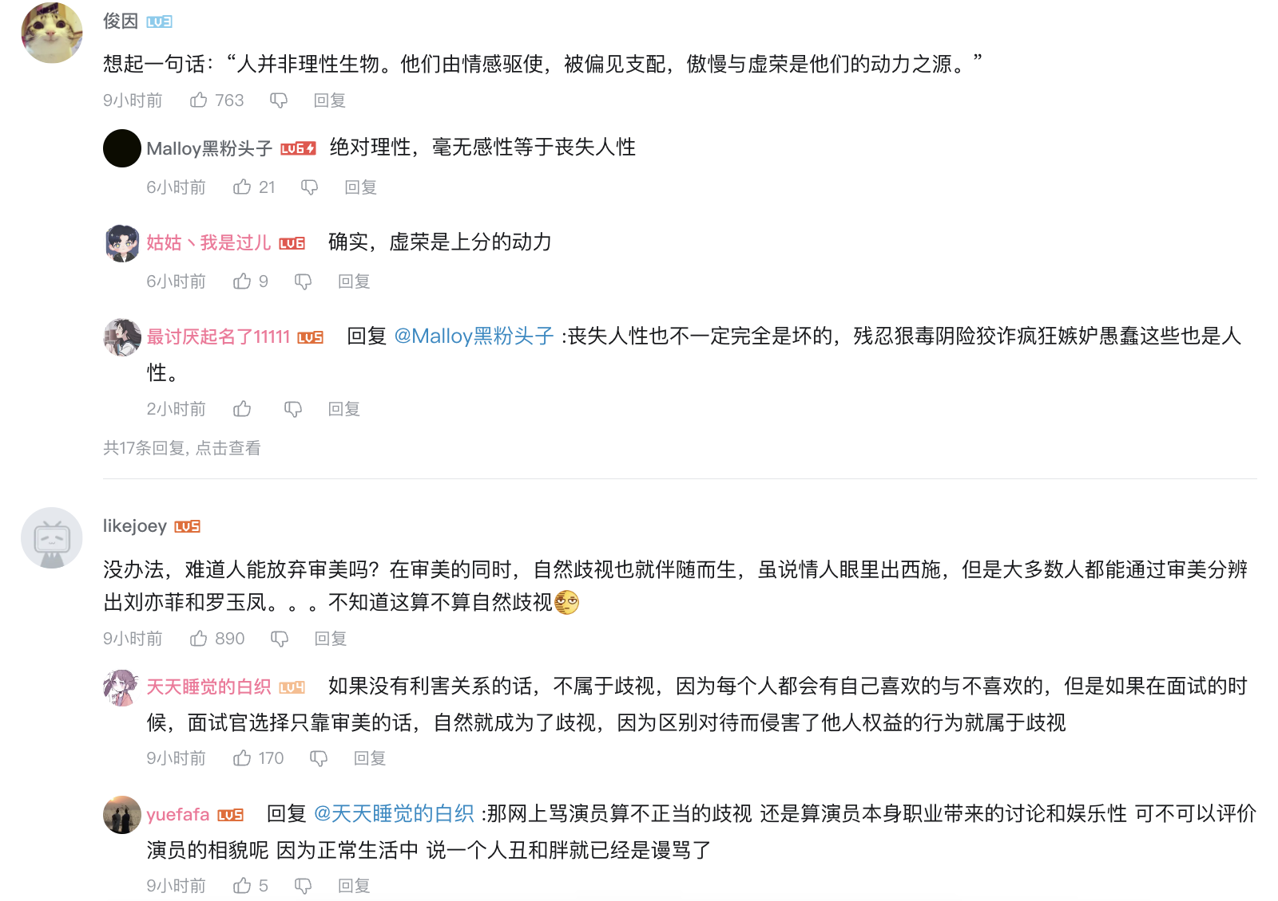
Novelty
Text content analysis
Find high-quality comments and bullet comments (弹幕) based on
Text similarity
Metrics (number of like, same text count, etc.)
Keyword matching
Use them together with video title and description to generate video summary
Notes:
Next, the novelty of the project. There are mainly three novelties. First, Text content analysis
Example …

Slide 10
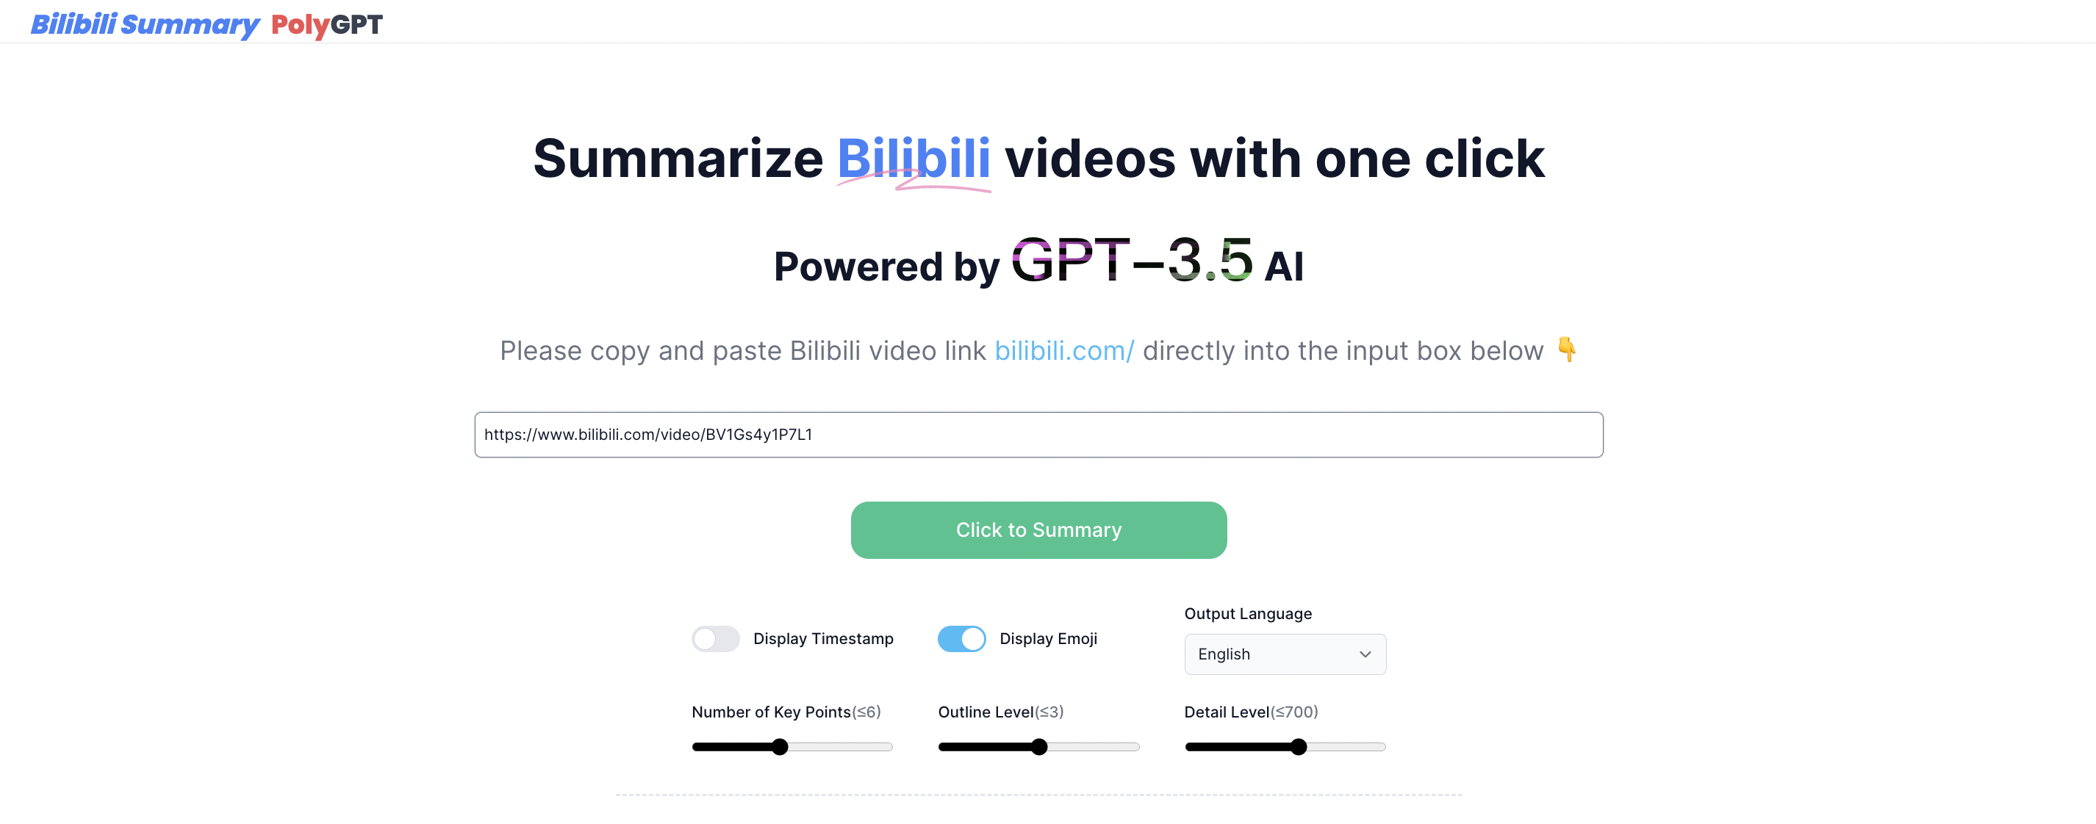
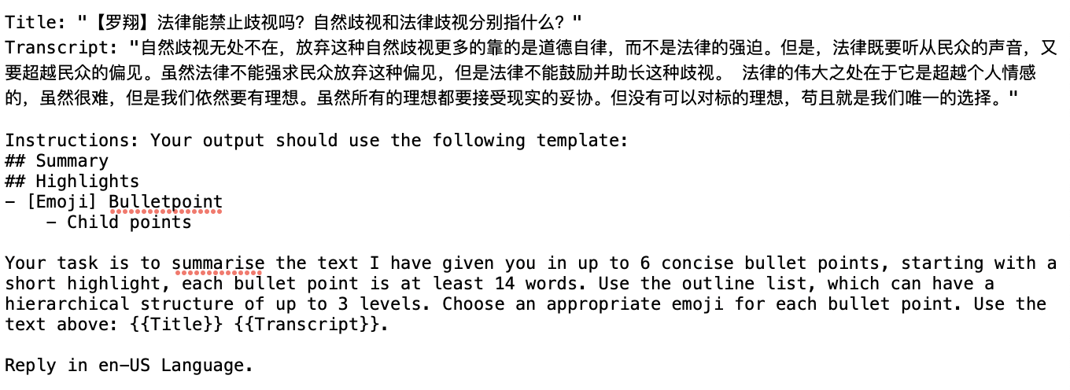
Novelty
Prompt design
Define number of key points, outline level, detail level, language, emoji and so on in the prompt.
UI on the webpage
←
Generated prompt
←
Notes:
Example …

Slide 11
Novelty
Query pipeline
Title
Description
Transcript
Bullet comment
Comments
Hieratics filtering
Summary
Bullet comment highlights extraction
Main idea summarization
Comment highlights extraction
Merge
Final result
Notes:
Example …

Slide 12
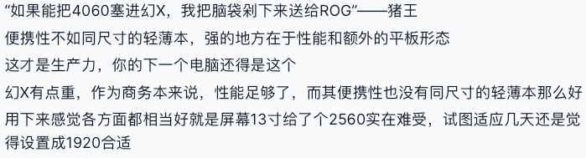
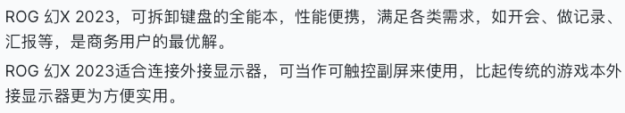
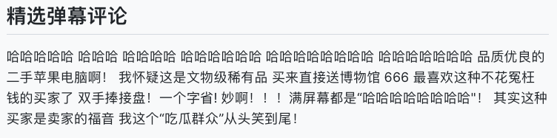
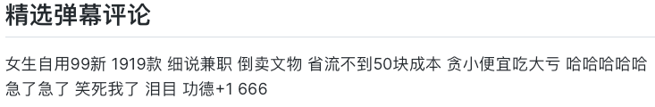
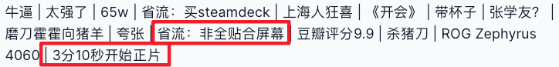
Novelty
Feature of summary *
Summary and keep original tone and intonation of comments
Keep diversity of bullet comments
Extract key video timestamp / key information
* To present it better, we use Chinese here

Slide 13
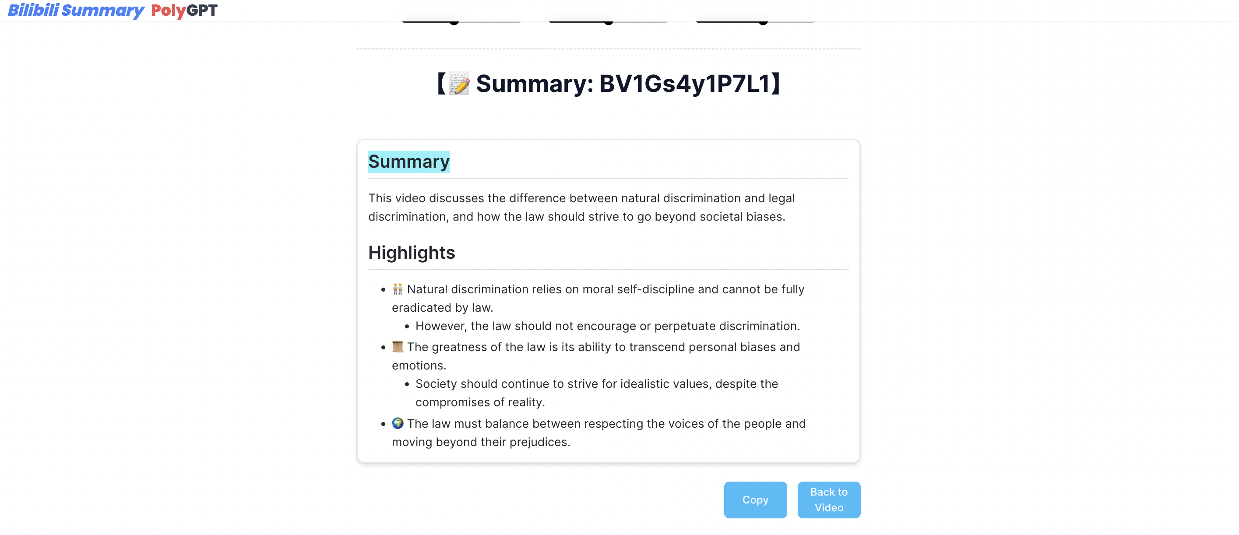
Demonstration
Notes:
Finally, I would like to show how the project works.
(Show how to start the whole project. Show one example, change the settings, show again)

Slide 14
THANK YOU!
Group 18
Qiao HE Jiayi HUA
Zhimin MEI Zhengxin YOU

